Slide 1
STEM - 2D -> 3D
2D Drawing to 3D

Slide 2
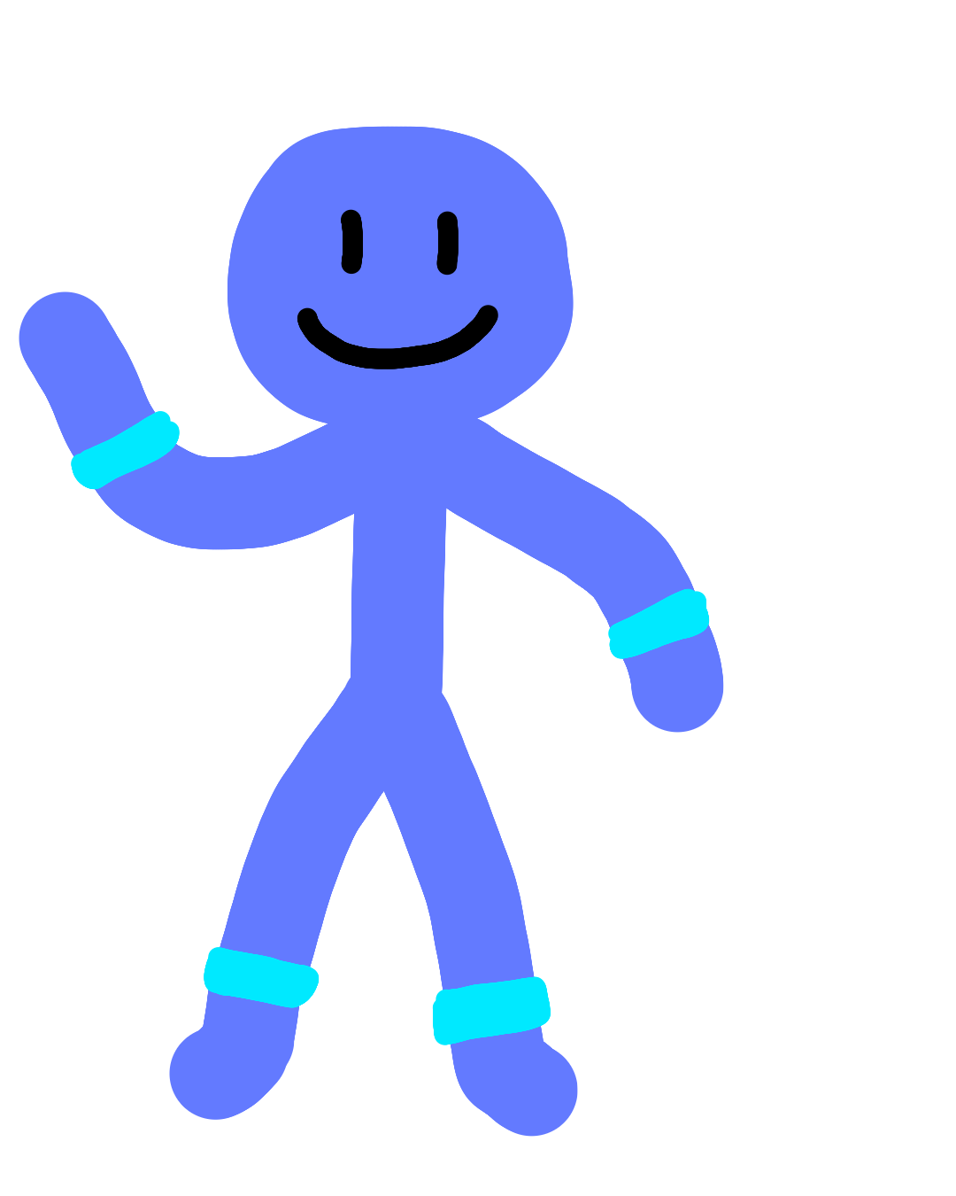
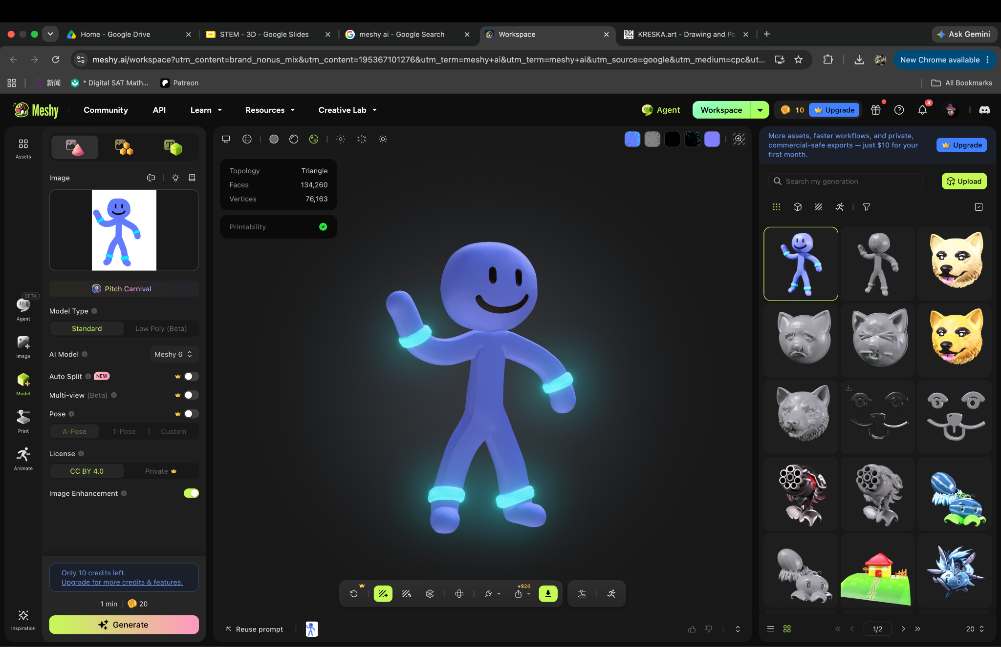
Assignment at the last slide
2D Drawing
3D Drawing
https://kreska.art/ for 2D
meshy.ai for 3D

Slide 3
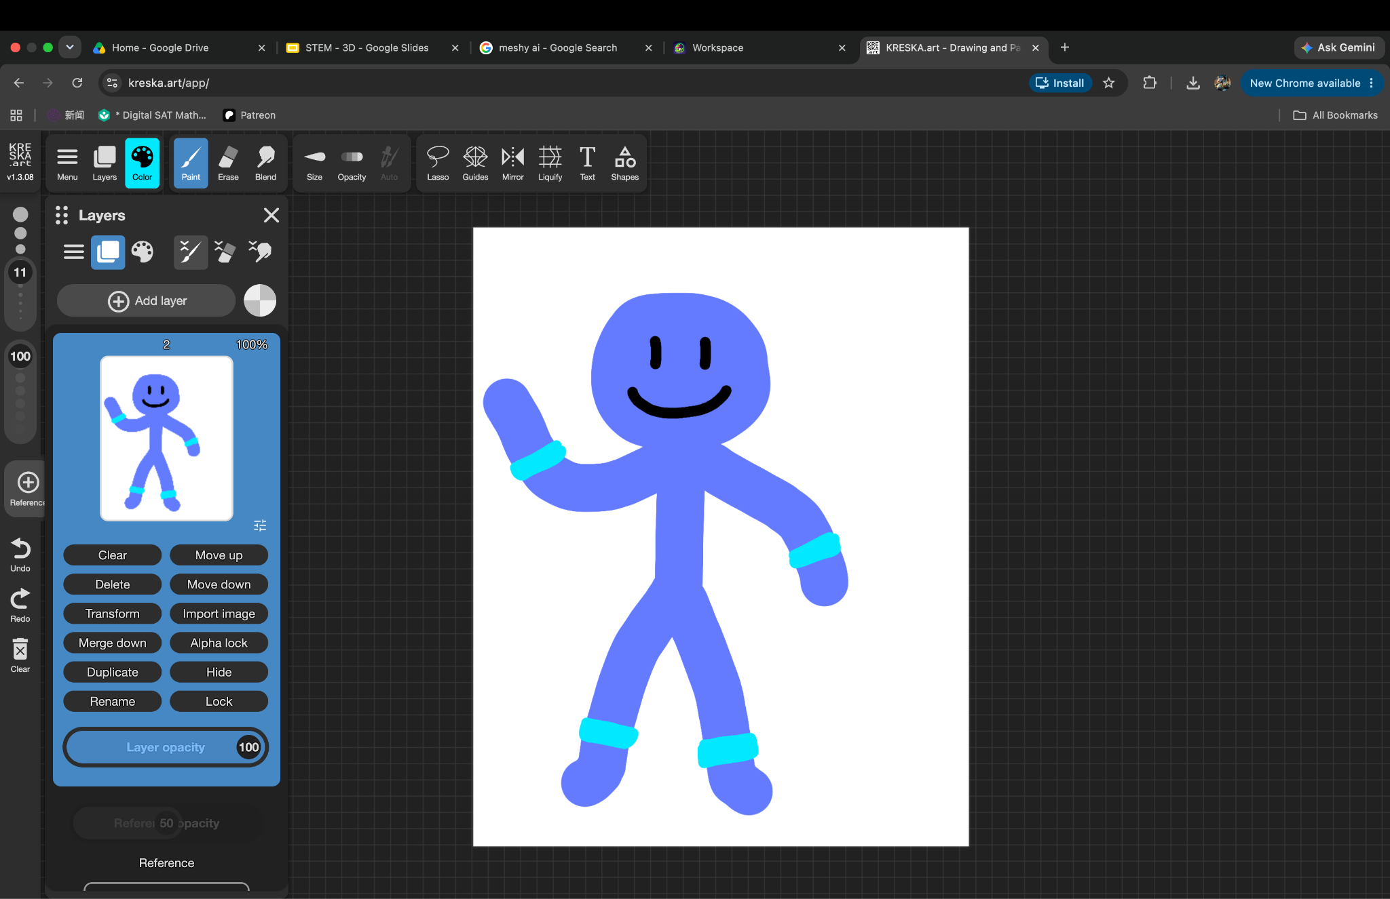
Go to https://kreska.art/ to draw any character you want.

Slide 4
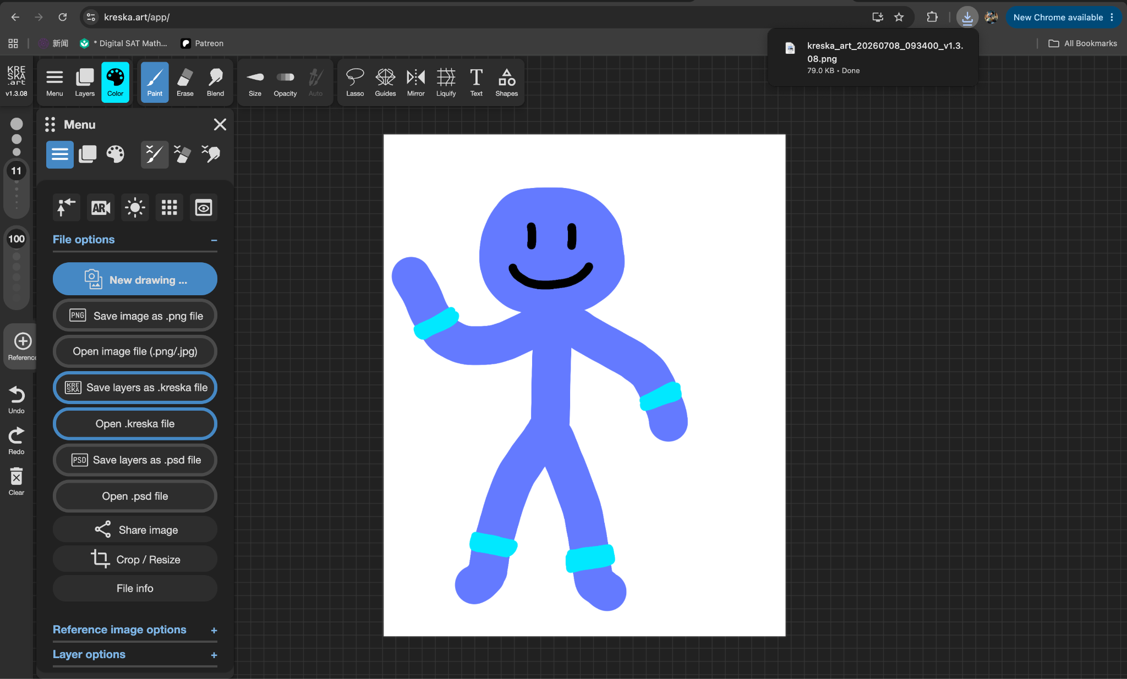
Save the image

Slide 5
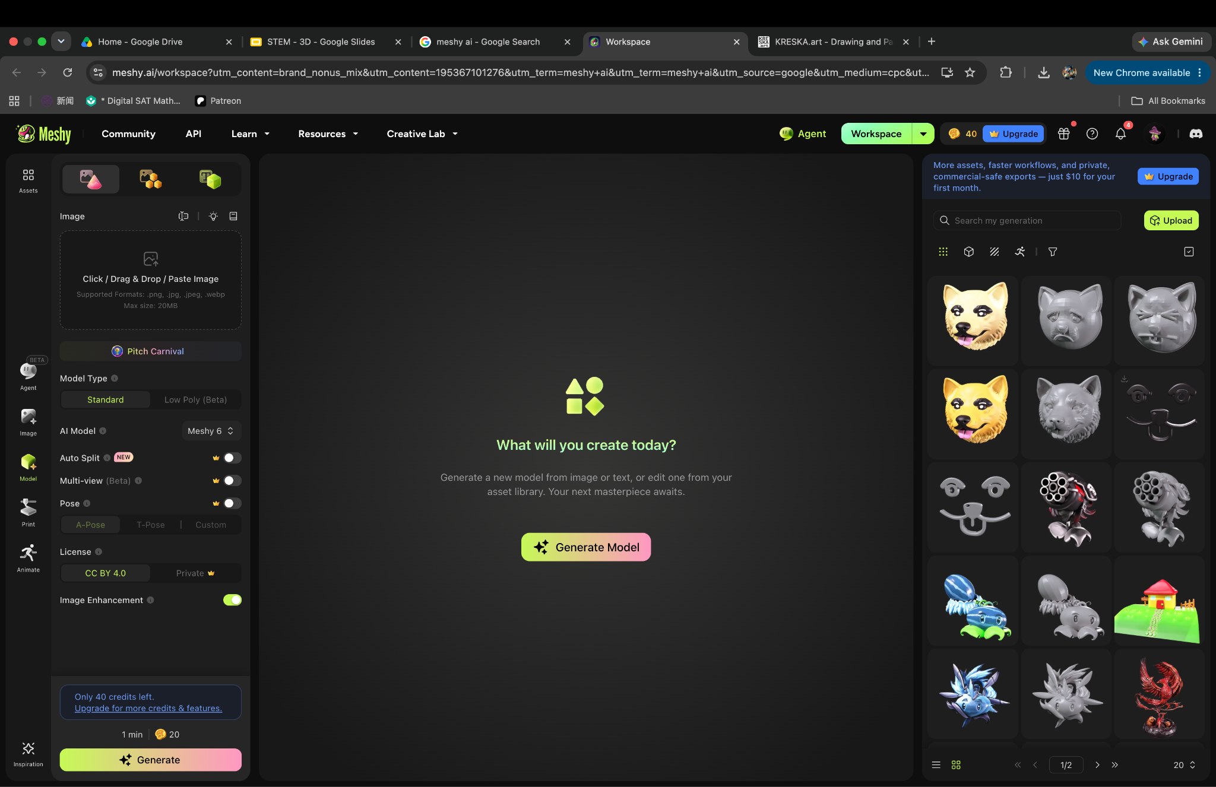
Go to meshy.ai

Slide 6
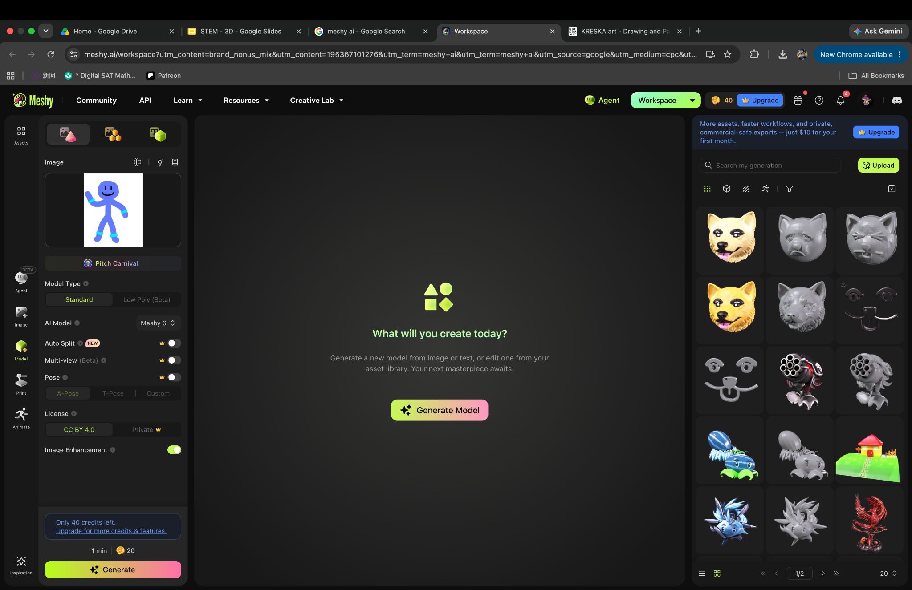
Put your drawing at that box, then hit “Generate”
1
2

Slide 7
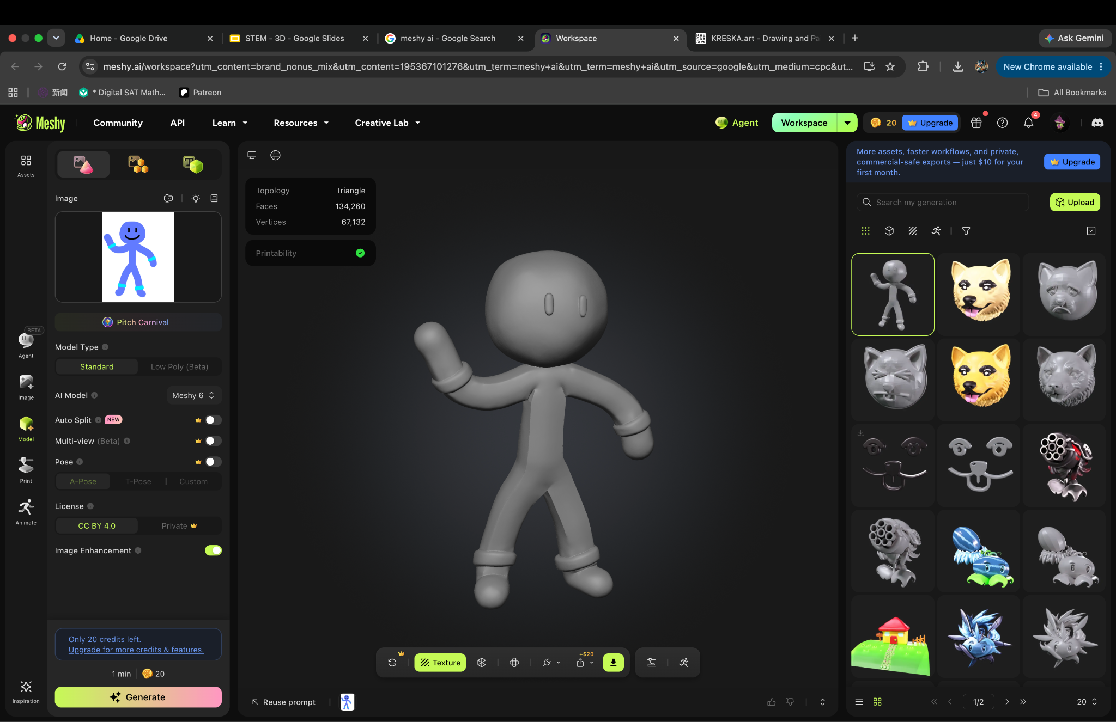

Slide 8
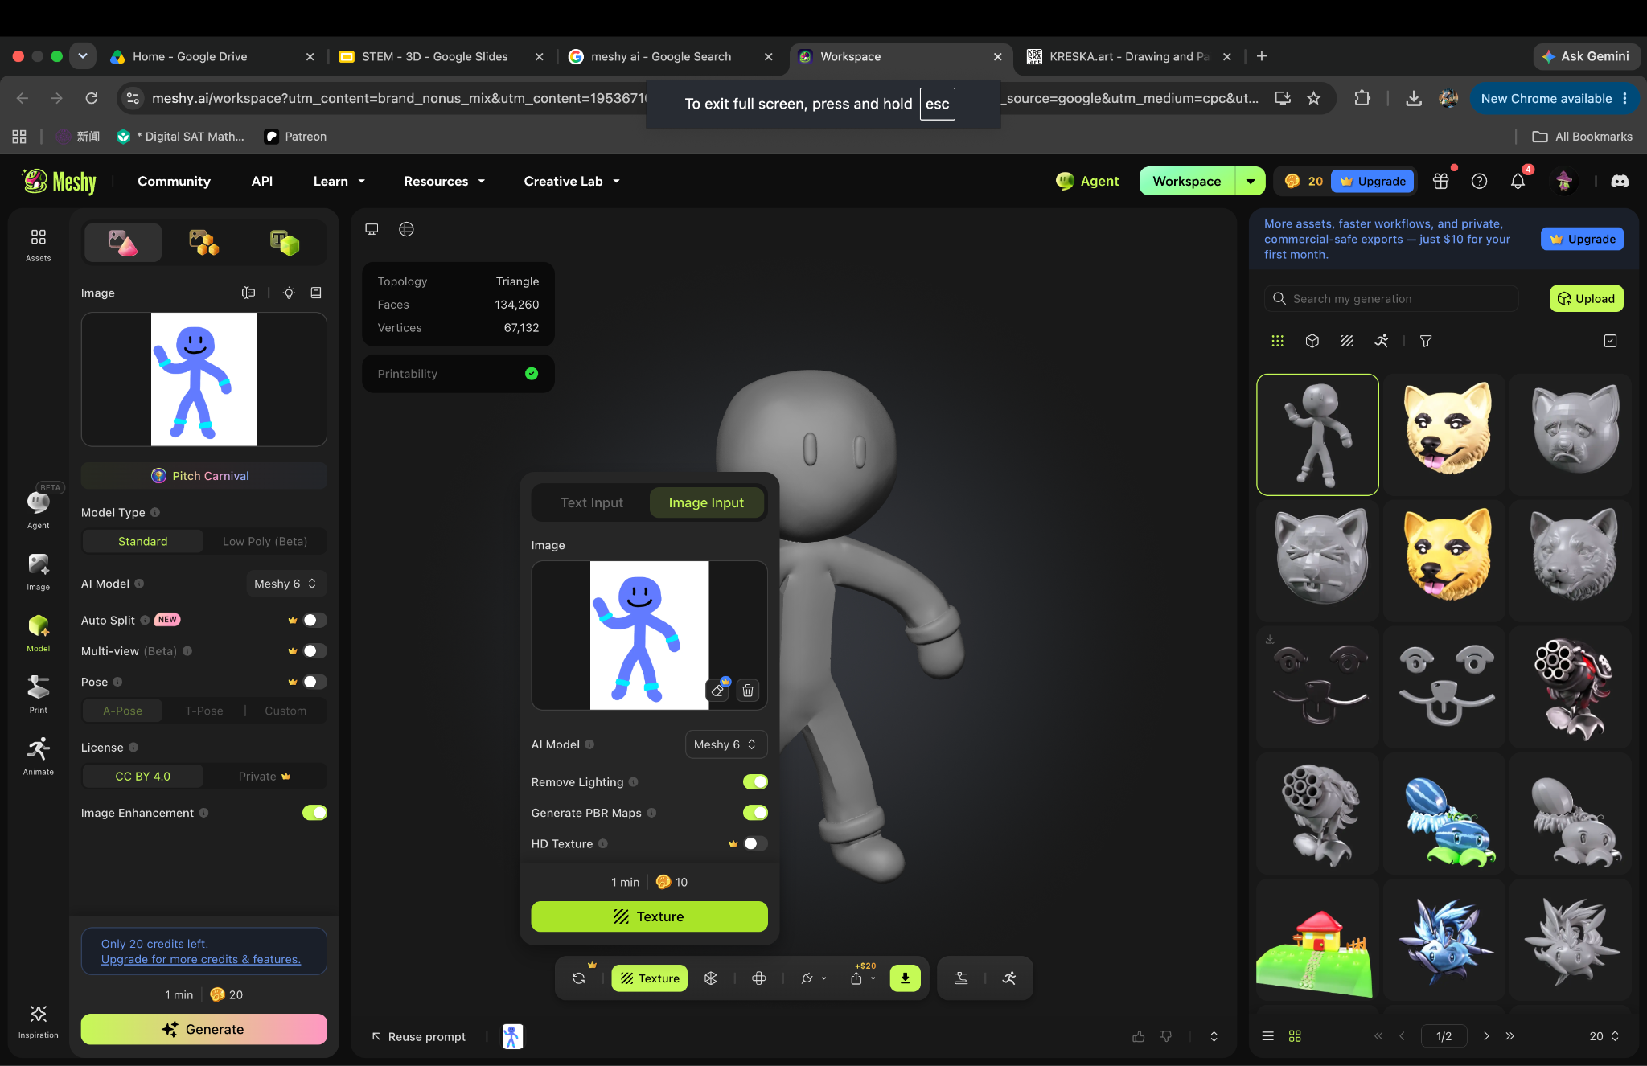
To get the color, click “Texture” and click “texture” again

Slide 9
Final Result:

Slide 10
2D Drawing
3D Drawing

Slide 11
Assignment:
Draw any character you want on https://kreska.art/.
Save the drawing and go to meshy.ai to upload your art to make it 3D.

